Slide 1

Battery Status Device 2.0
RoboJackets RoboCup - Electical
By Parker Abramson and Alex Schroeder

Slide 2
Schedule List
Project Context
System Summary
Subsystem Summary
Routing

Slide 3
Project Context
An off-robot device to determine the robot’s battery level by measuring its voltage
Contains a numerical 3-digit LED display which displays the voltage measurement
Also interprets battery voltage with 3 LEDs (red, yellow, and green lights for low, medium, and high battery)
Has buzzer as well which buzzes when the battery’s voltage is low

Slide 4
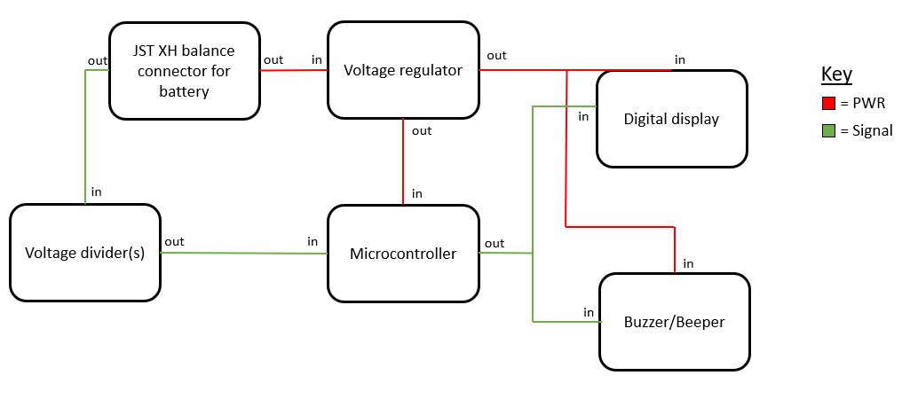
Block Diagram
System Summary

Slide 5
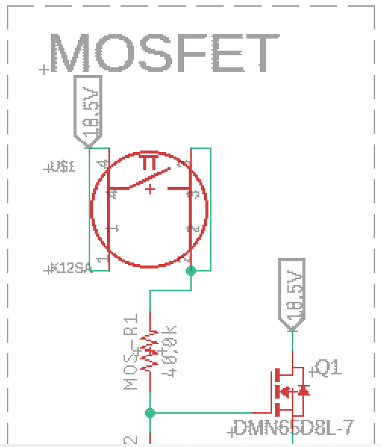
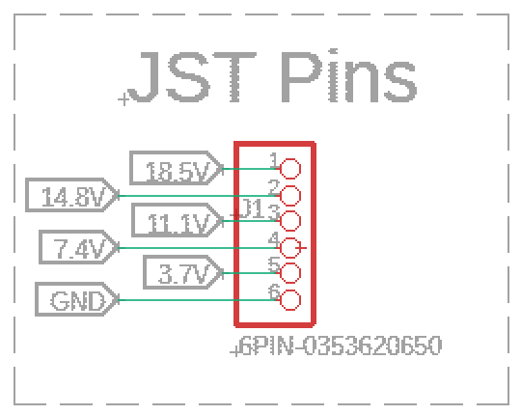
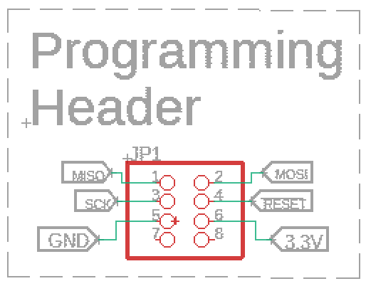
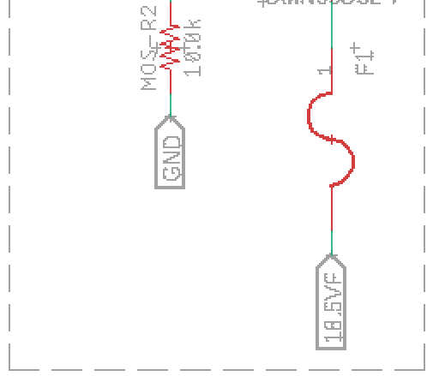
JST Pins, Programming Header, and MOSFET

Slide 6
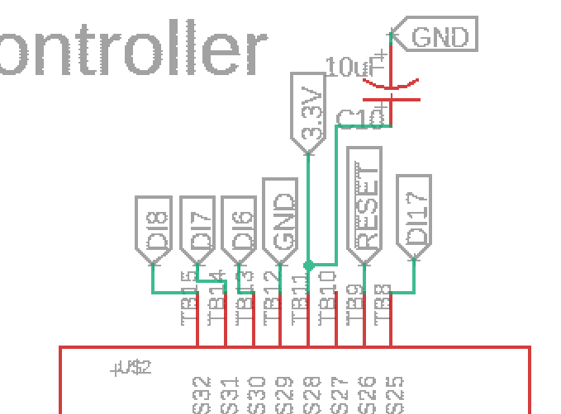
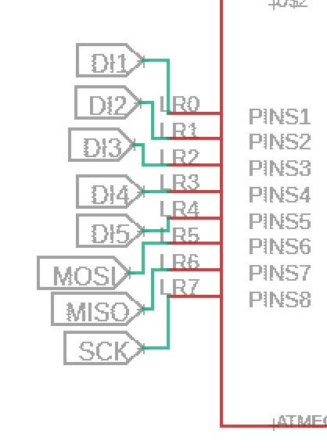
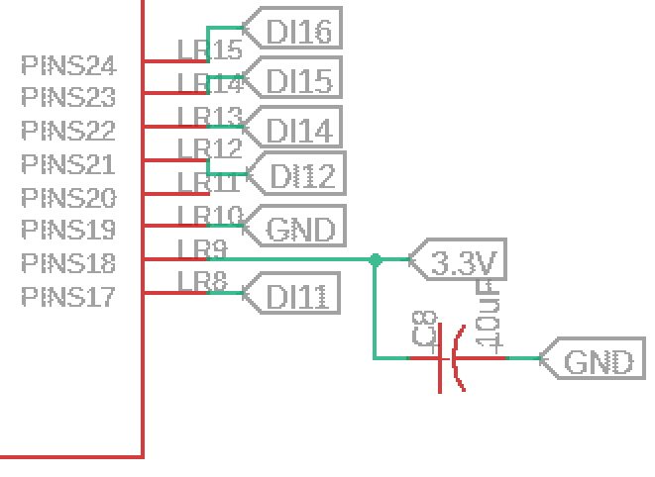
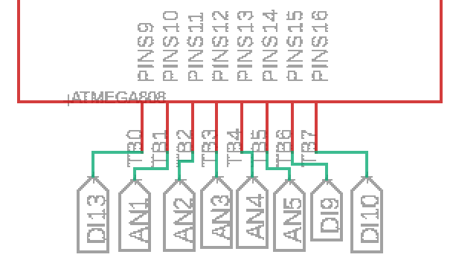
Microcontroller
Pins 1–4, 9, 15-17, 21-25, and 30-32 for digital display
Pins 6–8, 26 for programming
Pins 10-14 for analog input from voltage divider
Pins 19 and 29 for ground
Pins 18 and 28 for 3.3V

Slide 7
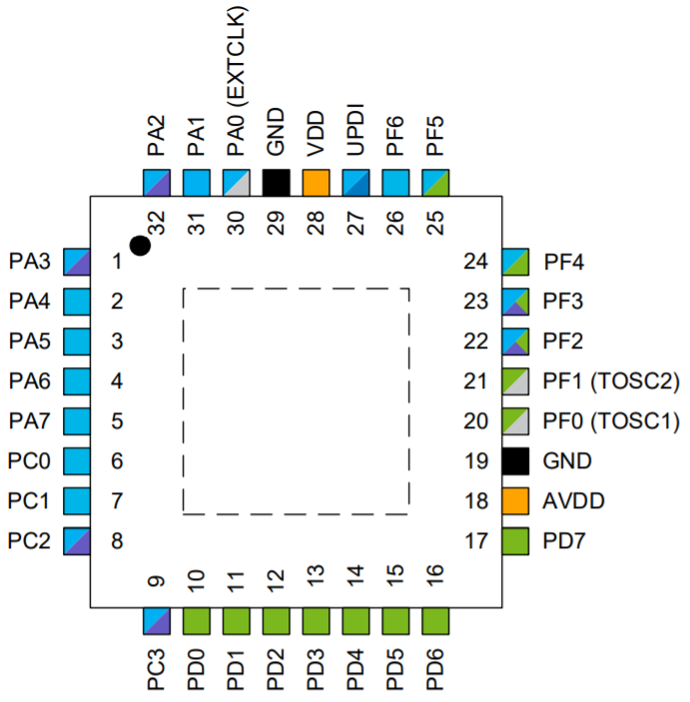
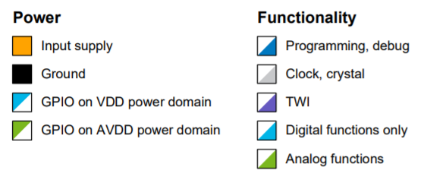
Microcontroller Key

Slide 8
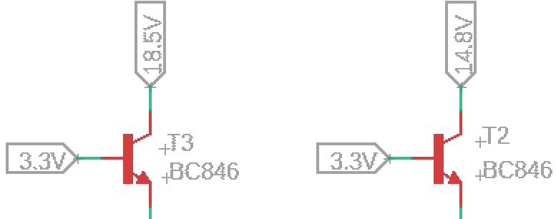
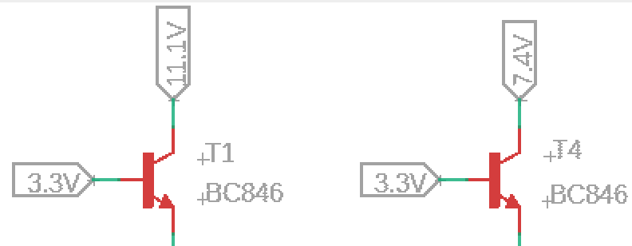
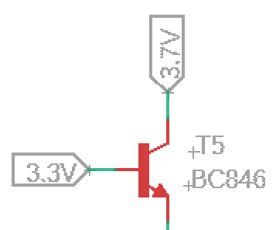
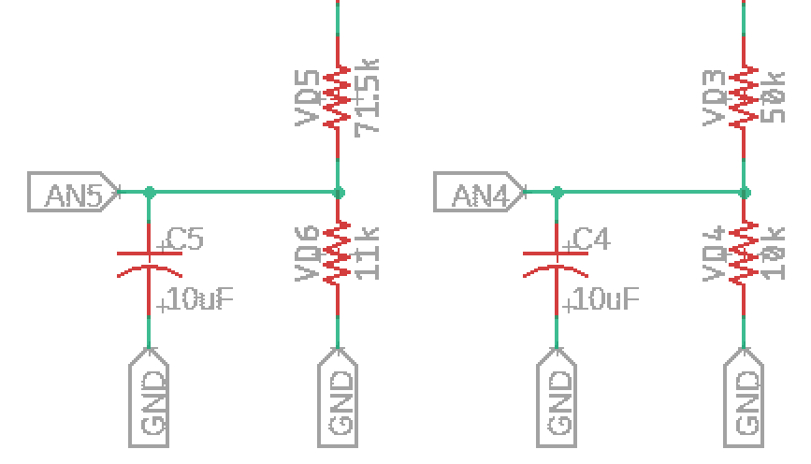
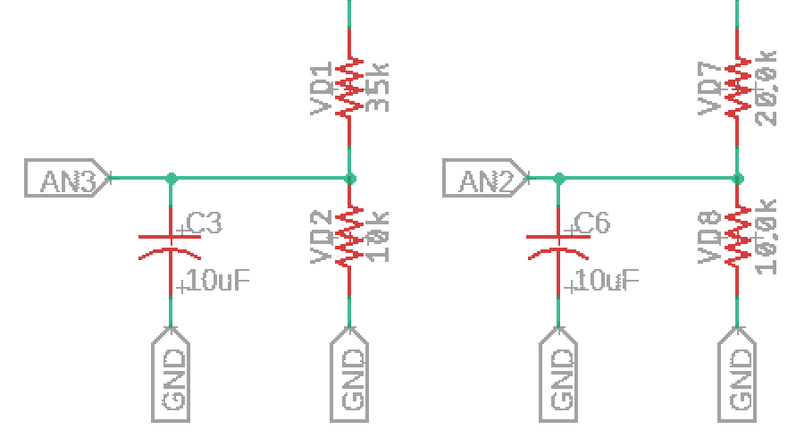
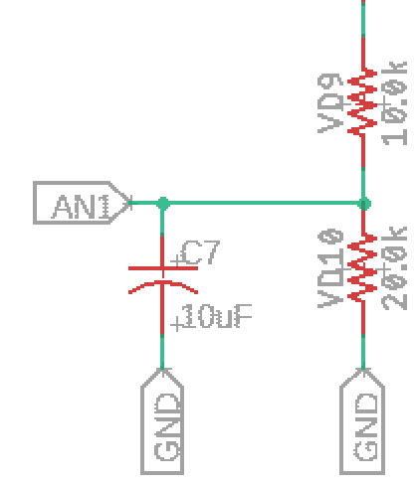
Voltage Divider

Slide 9
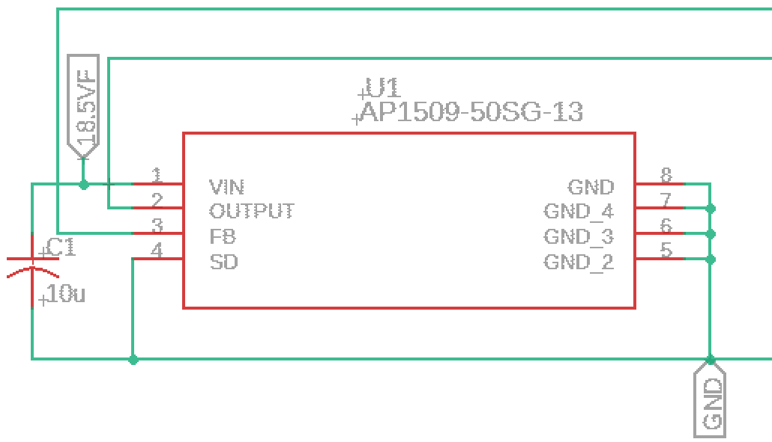
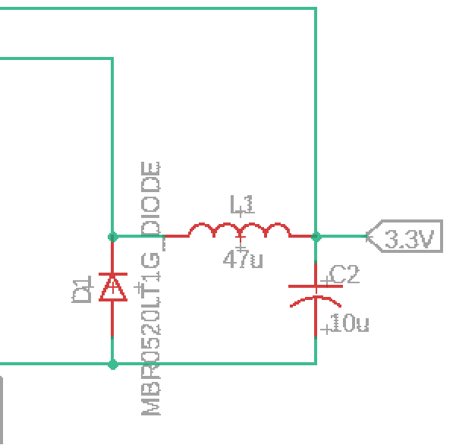
Voltage Regulator

Slide 10
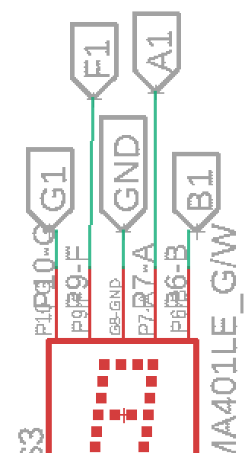
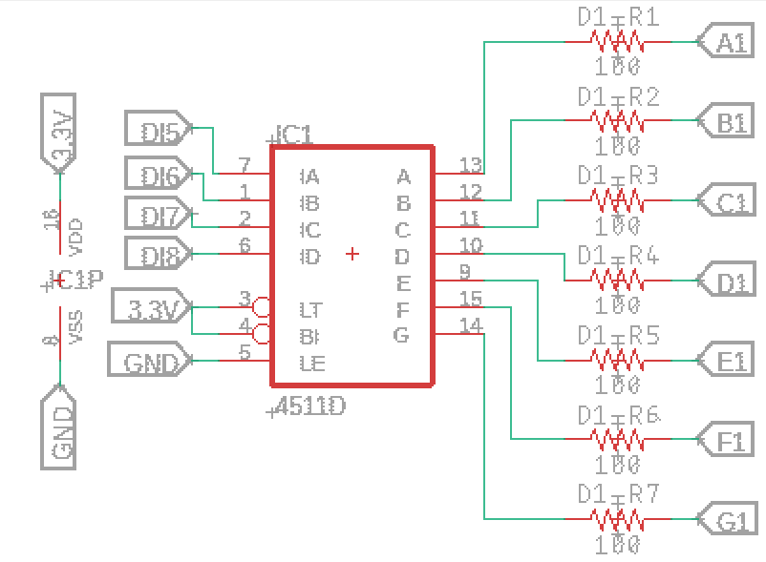
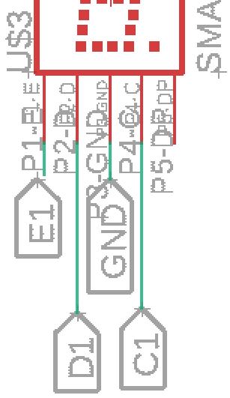
Output: Numerical LED Display
First Digit

Slide 11
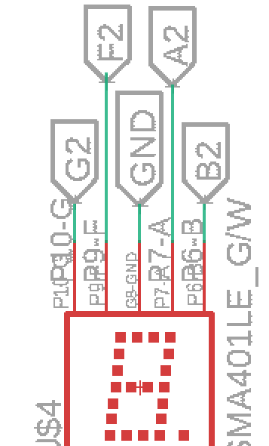
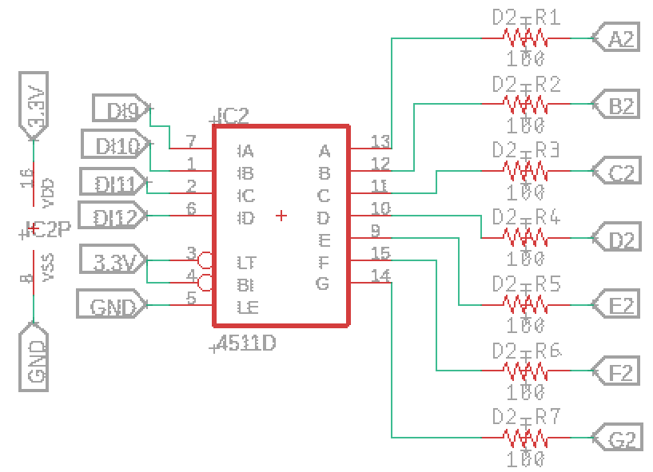
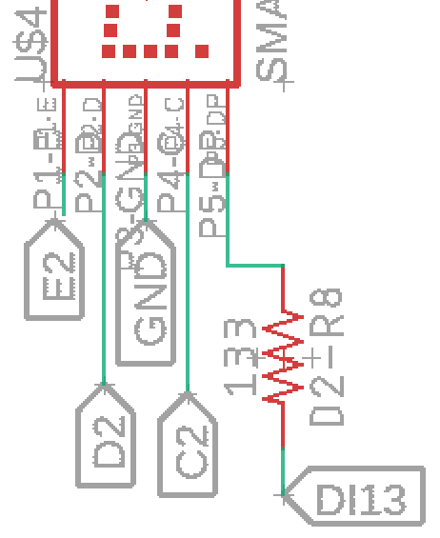
Output: Numerical LED Display
Second Digit

Slide 12
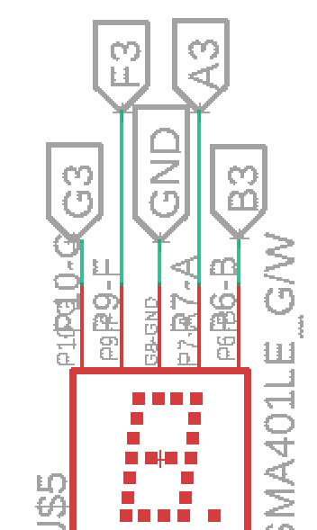
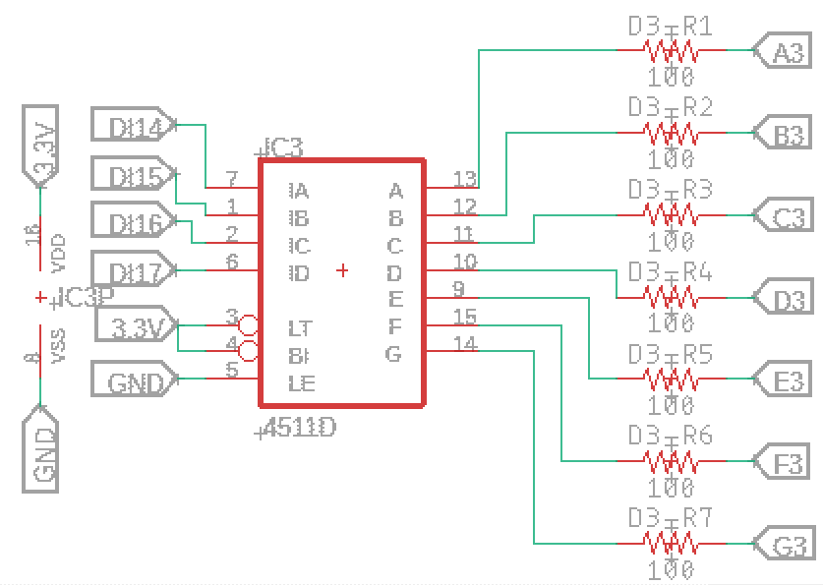
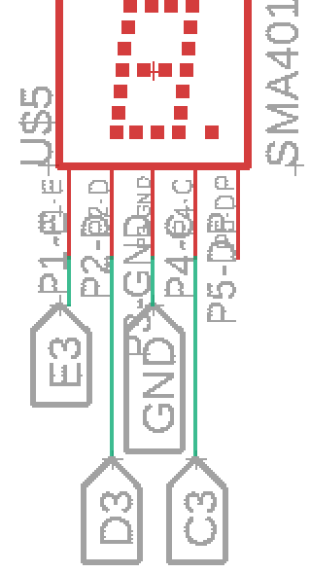
Output: Numerical LED Display
Third Digit

Slide 13
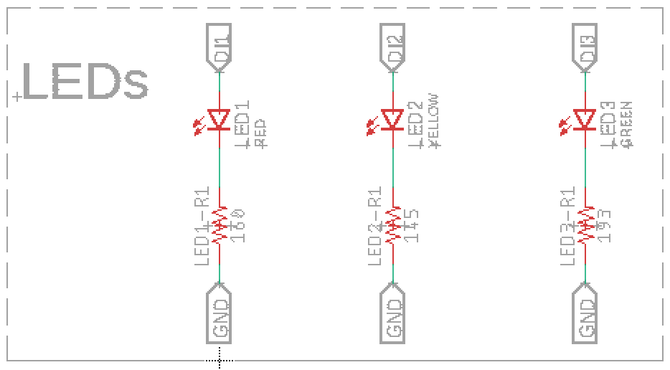
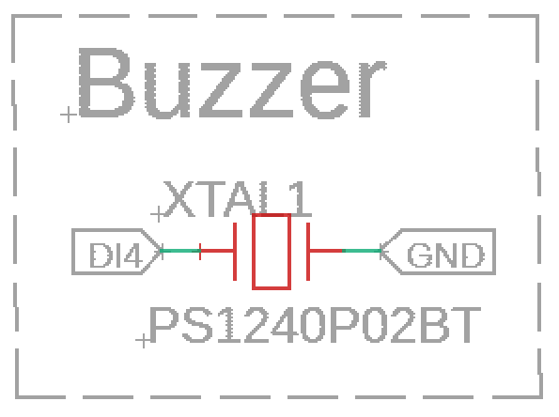
Outputs: LEDs and Buzzer

Slide 14
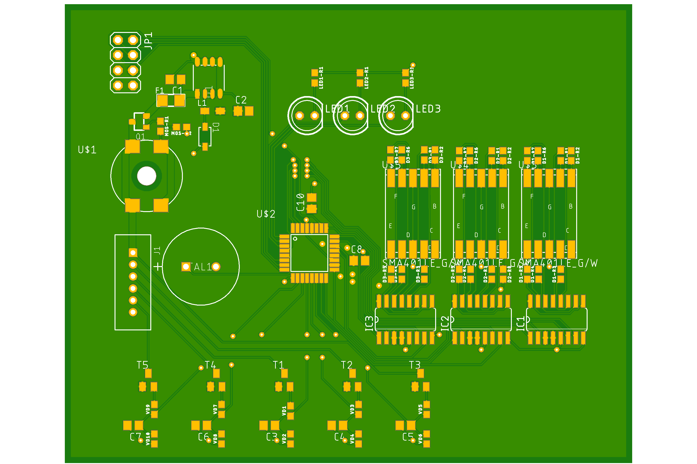
Routing (PCB)

Slide 15
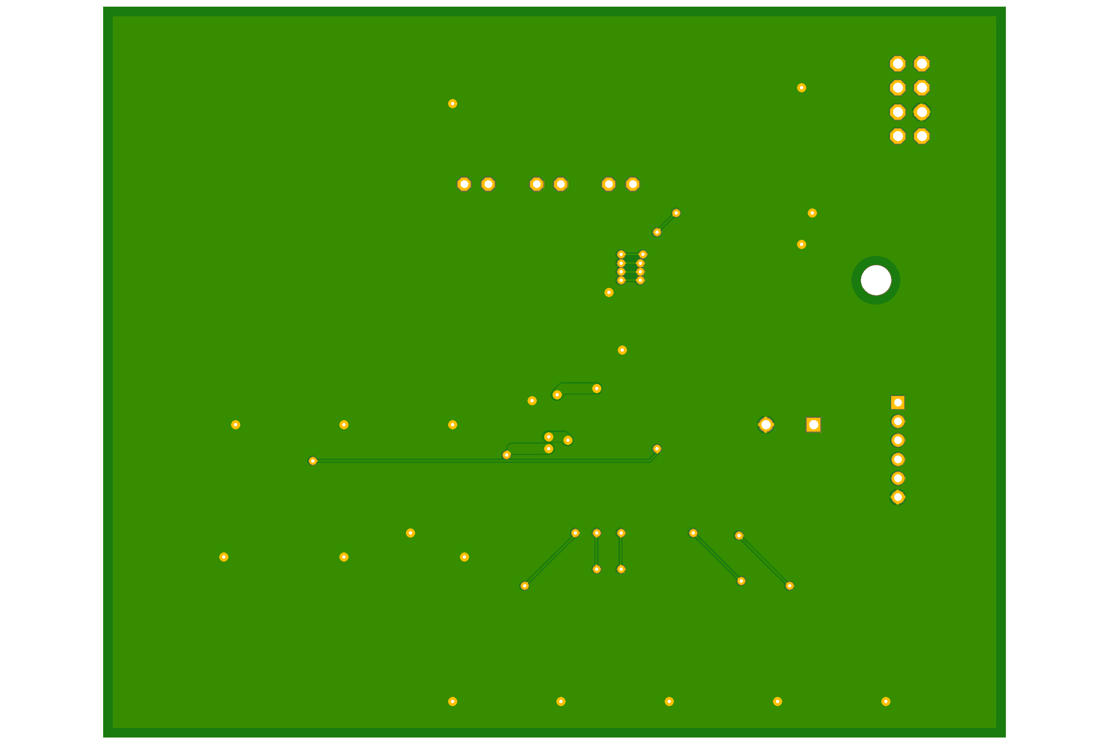
Routing (Back)

